Slide 1
DEVOPS weekend

Slide 2


cvs

Slide 3


Slide 4
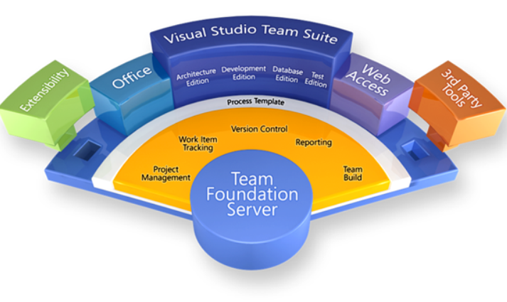
ALM 1.0

Slide 5


Slide 6
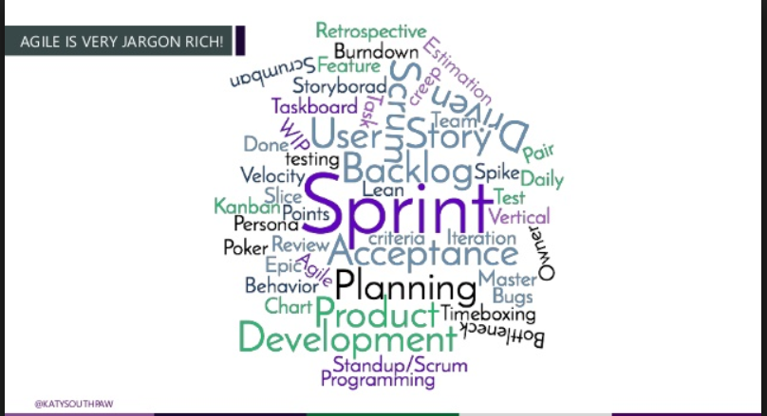

Slide 7

2013

Slide 8
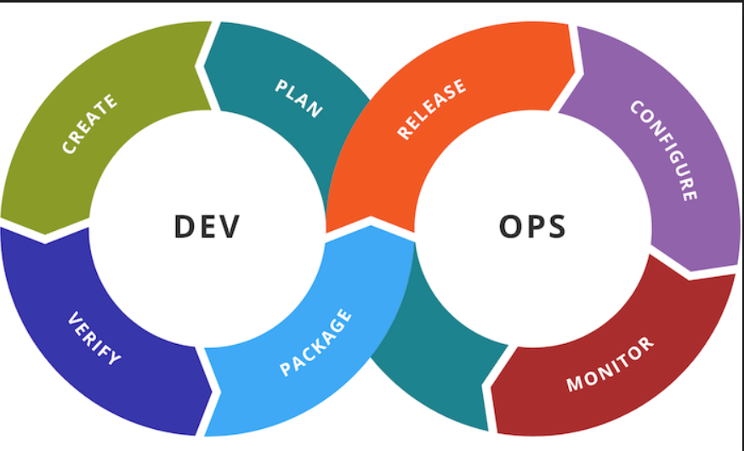
ALM 2.0

Slide 9
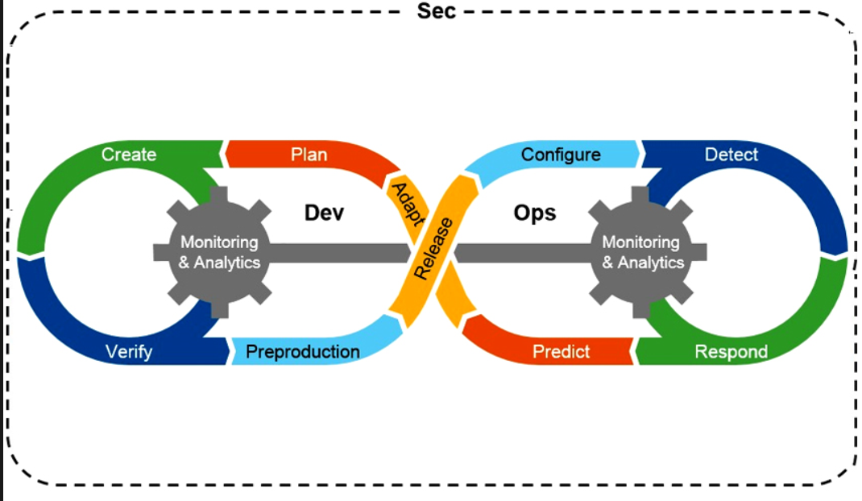
ALM 3.0

Slide 10


Slide 11


Slide 12


